Slide 1
Nabeeha Shoaib
AICT LAB

Slide 2

Shapes and icons
sun

Slide 3

Landscapes
Green lake with
Water falls

Slide 4


Slide 6



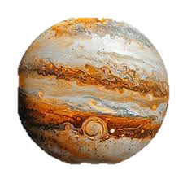
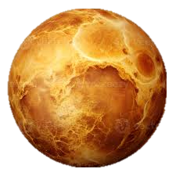



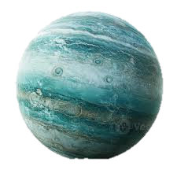


Slide 7

Logical gates:
AND GATE
OR GATE
XOR GATE

Slide 8
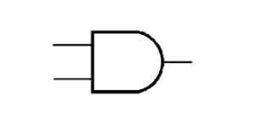
And gate (a*b):
0
0
0

Slide 9
0
0
1

Slide 10
1
0
0

Slide 11
1
1
1

Slide 12
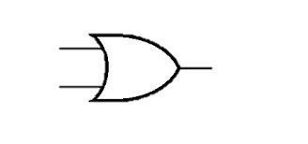
Or gate (a + B):
0
0
0

Slide 13
0
1
1

Slide 14
1
1
0

Slide 15
1
1
1

Slide 16
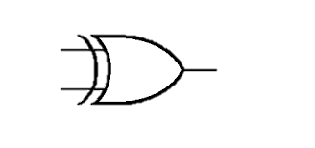
Xor gate:
0
0
0

Slide 17
0
1
1

Slide 18
1
1
0

Slide 19
1
0
1

Slide 20


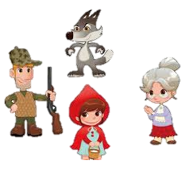
STORY (ANIMATED STORY)
LITTLE RED RIDDING HOOD:
1.Once there was a cute girl named Red. One day she knew that her grandma is ill. So she decided to meet her.

Slide 21
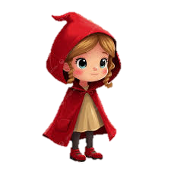
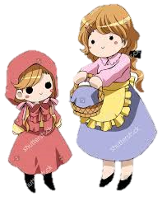
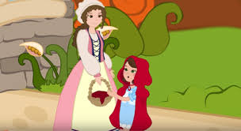
2.Red’s mother giving her basket of fruits. So she went to see her grandma that was ill.
3. She advised her not to talk with stranger.
And said good bye!

Slide 22
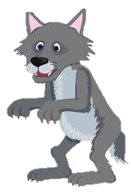
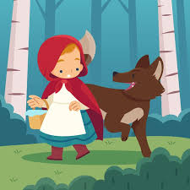
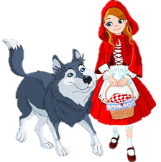
4. On the way, she saw a wolf. The wolf was starving. When the wolf saw red, he became happy. He wanted to eat red. So he made a plan.
5. He went to the red and asked her Where are you going? Little Red told him all the conditions under which she went to see her grandmother, who was ill.

Slide 23
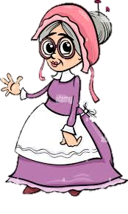

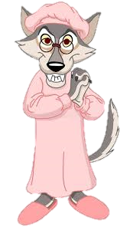

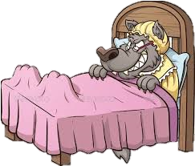
6. The wolf became happy and went to Grandma’s house before her. Instantly, he reached Grandma’s house. He knocked on the door.
And entered the house. He tied Grandma with ropes.
7.The wolf wore the dress of grandma and lay down in Grandma’s bed. After some time, Red reached her grandma’s house. She entered the house, and her grandma was lying on the bed, which was actually a wolf. She asked her why your teeth are so large. Suddenly, the wolf jumped out of the bed.

Slide 24
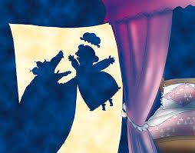
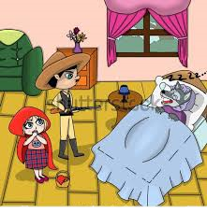
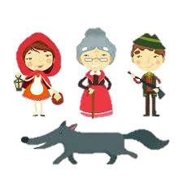
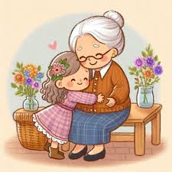
8. He attacked on red, but suddenly a hunter came and shot the wolf at the right time and saved the red. Otherwise, red would be died.
9. She also saved her grandma and hugged her. From that day, Red never talked to strangers.

Slide 25


